Slide 1





FACIAL MOTE
MOUSE CURSOR CONTROL USING FACIAL MOVEMENTS
INTERNAL GUIDE:
DR. FOUSIA M SHAMSUDEEN
PRESENTATION BY
ARUN J
ROLL NO:11
S4 MCA

Slide 2
TABLE OF CONTENTS
SI NO | CONTENTS
1 | INTRODUCTION
2 | RELATED WORKS
3 | GAP IDENTIFIED
4 | OBJECTIVE
5 | PROBLEM STATEMENT
6 | METHODOLOGY
7 | RESULTS
8 | REFERENCE

Slide 3
1. INTRODUCTION
Facial Mote is a system that allows users to control their computer mouse using facial gestures rather than traditional input devices like a mouse . To enhance accessibility for individuals with physical disabilities or conditions that limit their ability to use conventional input methods.
It opens doors to a realm of possibilities in hands-free computing, gaming, virtual reality, and beyond. By eliminating the need for physical input devices, Facial Mote transcends barriers and fosters a more inclusive digital ecosystem for users of all abilities.

Slide 4
2. RELATED WORKS
SL .NO | Title of paper, Author name, Publisher, year | Pros of the paper | Cons of the paper
1 | Real-Time Hands-Free Mouse Control for Disabled. Ghadekar, P., Korpal, P., Chendake, P., Bansal, R., Pawar, A., Bhor, S. In: Swain, D., Pattnaik, P.K., Athawale, T. (eds) Machine Learning and Information Processing. Advances in Intelligent Systems and Computing, vol 1311. Springer, Singapore. 2021 | To enhance accessibility for individuals with physical disabilities or conditions that limit their ability to use conventional input methods. | The facial mouse control system doesn't accurately track the movements of the user's face, leading to mistakes in controlling the mouse.

Slide 5
SL .NO | Title of paper, Author name, Publisher, year | Pros of the paper | Cons of the paper
2 | Human hand gesture based system for mouse cursor control, Procedia Manufacturing, Horatiu-Stefan Grif, Trian Turc, Science Direct, 2018. | By utilizing hand gestures, users can interact with digital interfaces more easily and independently. | Not be suitable for individuals with certain types of disabilities as particularly those that affect hand mobility or dexterity.

Slide 6
3. GAPS IDENTIFIED
The system may not work well for everyone, especially for individuals with certain facial features, disabilities, or in different lighting conditions.
The system doesn't accurately track the movements of the user's face, leading to mistakes in controlling the mouse.
Some users may find it difficult to learn how to use facial mouse control effectively, especially if they are accustomed to using traditional input devices.

Slide 7
4. OBJECTIVE
To Improve the accuracy of Facial Mote in tracking facial movements and translating them into precise mouse actions, ensuring a seamless and responsive user experience.
To Extend the functionality of Facial Mote to include a wider range of mouse actions and customizable gestures, allowing users to perform diverse tasks efficiently and effectively.
To Enhance Facial Mote's adaptability to different user profiles, facial features, and environmental conditions, ensuring reliable performance for a diverse user base.
To Streamline the user interface of Facial Mote to make it intuitive and user-friendly, minimizing the learning curve and enhancing accessibility for users of all abilities

Slide 8
5. PROBLEM STATEMENT
Existing systems often struggle with accuracy and reliability, leading to erratic cursor movements and inconsistent user experiences. Variability in facial features, lighting conditions.
The complexity of configuring and using facial mouse control systems presents a significant barrier for users, particularly those with limited technical expertise or cognitive impairments.

Slide 9
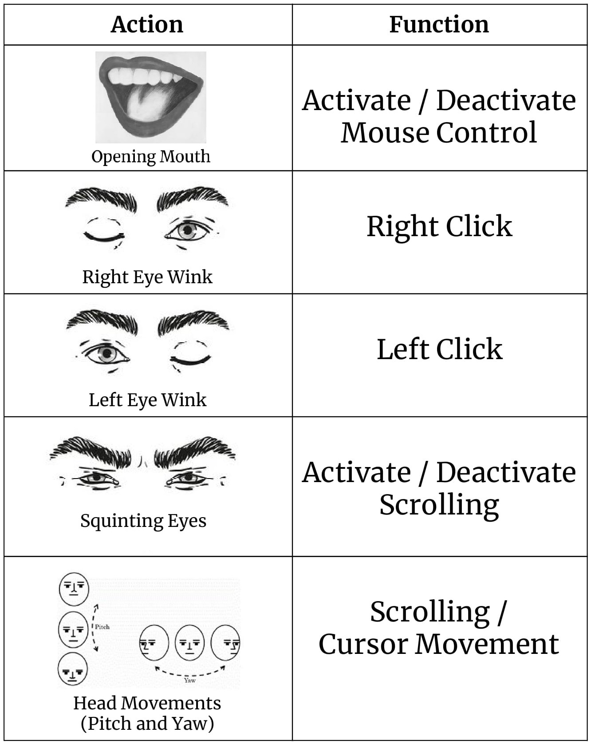
Facial Gestures as Input

Slide 10
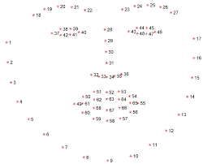
6. METHODOLOGY
Facial Landmarks Prediction Model: The system relies on facial recognition to identify and process specific areas on the face.These predicted marks are used to enable the system to detect and respond to different facial movements.
By performing expected facial expressions, specific features can be produced that enable us to detect blinks through Eye-Aspect-Ratio and yawns through Mouth- Aspect-Ratio. These actions are programmed using the PyAutoGUI module to manipulate the mouse cursor.
Fig: The pre-existing facial landmark detector contained in the dlib library is employed to approximate the placement of 68 coordinate pairs (x, y) that correspond to various facial features on the visage.

Slide 11
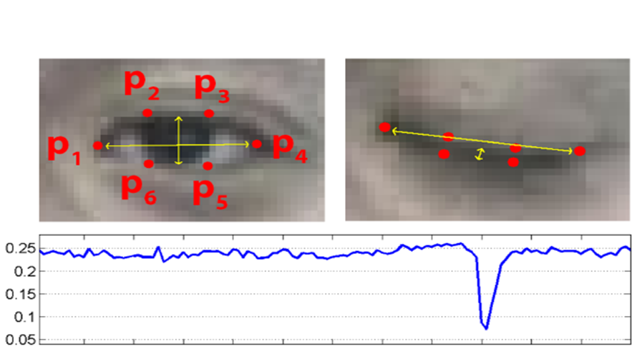
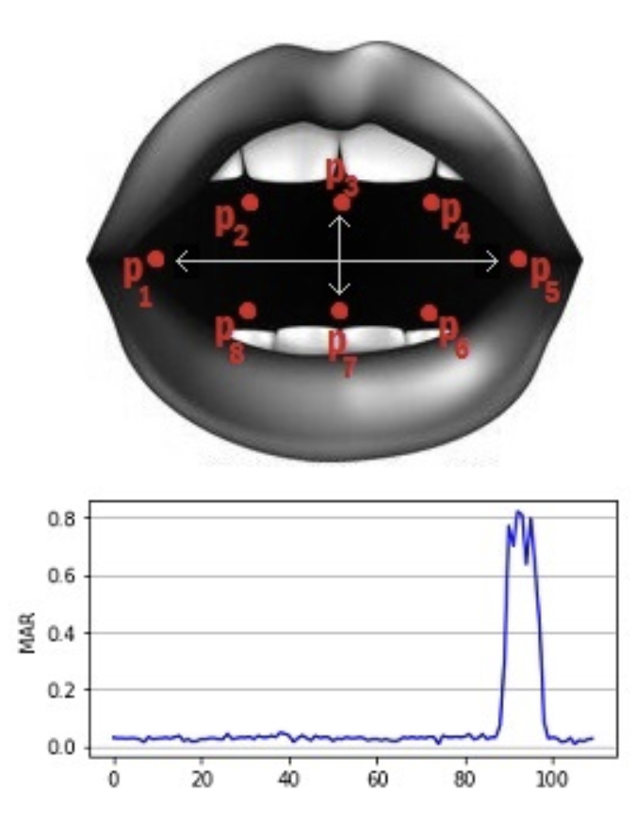
Eye Aspect Ratio [EAR]: This can be utilized to identify eye blinks and winks. When the eye is shut, the EAR value will decrease below a predetermined threshold, whereas an open eye will result in an EAR value above the threshold.
If EAR >= THRESHOLD
STATUS=‘CLOSE’
Mouth Aspects Ratio [MAR]: The system is designed to identify the opening and closing of a person's mouth, with the mouth aspect ratio (MAR) value increasing when the mouth is open and decreasing when it's closed.
If MAR <=THRESHOLD:
STATUS = ‘CLOSE’

Slide 12
IMPLEMENTATION
The first step involves defining all the necessary threshold values and initializing counters of frame and frame length, which are used to drive mouse action.
The next step is to obtain the facial corners from the HOG face sensor and gain the indicators of facial landmarks for the mouth, both eyes, and nose.
Following this, the face in the image frame is converted into grayscale format, and the facial marks coordinates (x, y) are stored in a NumPy array. Subsequently, the Eye Aspect Ratio and Mouth Aspect Ratio are computed.
Finally, a bounding box is drawn exactly from the center of the nose, and the necessary functions can be performed within that bounding box.

Slide 13
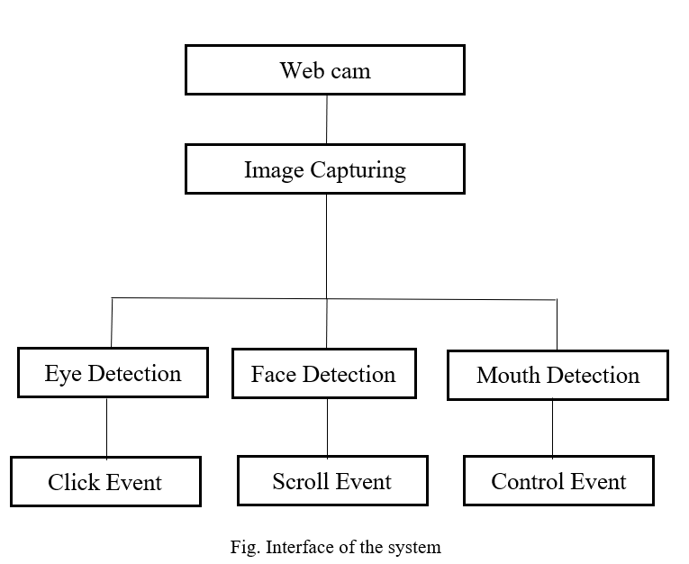
WORKING

Slide 14
7.RESULTS
The movement of the pointer will be in the same direction as the head movement. The mechanism will control basic mouse actions such as moving in all directions, left-clicking, right-clicking, and scrolling.
The system activates the cursor by opening the mouth, and the movement of the pointer can be controlled by gazing at the head.
The clicking events are performed by making winks with the eyes.
For left-clicking, a wink with the left eye is used, and for right-clicking, a wink with the right eye is used.
By squinting the eyes, scrolling can be activated, and the same action deactivates it.

Slide 15
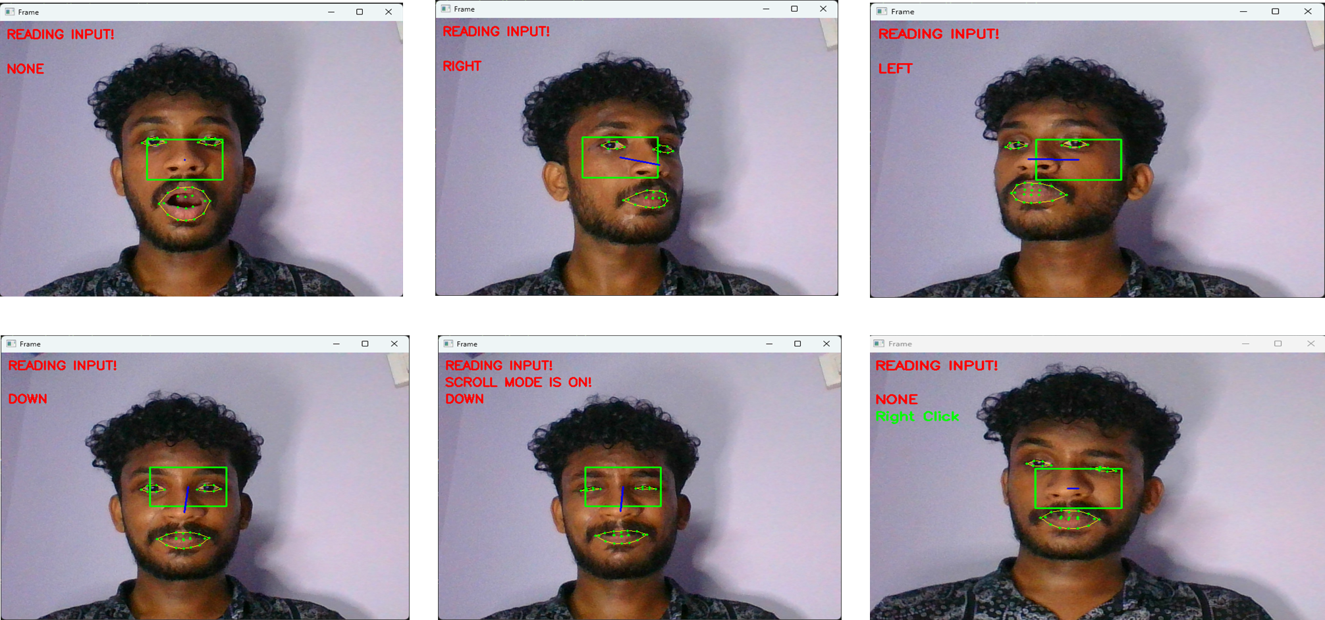
SCREENSHOTS

Slide 16
FUTURE DIRECTIONS
I also aim to incorporate advanced features such as voice recognition and text extraction for typing, as well as dragging, zooming in, and zooming out.
Also designing an interface that can be implemented in real-life applications, specifically to assist physically handicapped users in operating a PC or laptop using their movements and facial expressions, without requiring the assistance of others.

Slide 17
8.REFERENCES
[1] Ghadekar.P et al. “Real-Time Hands-Free Mouse Control for Disabled” (eds) Machine Learning and Information Processing. Advances in Intelligent Systems and Computing, vol 1311. Springer, Singapore. 2021
[2] Horatiu-StefanGrif et al. “Human hand gesture based system for mouse cursor control ” Procedia Manufacturing, Science Direct,2018.

Slide 18
THANK YOU

